Slide 1
World Languages and Cultures

Slide 2
World Languages and Cultures
Enduring Understandings:
• Learning about other cultures benefits us as individuals as well as our society.
• Language reflects the essence and perspective of a people and their culture.
• Certain linguistic structures and vocabulary are required for effective communication in and understanding of a second language.
Effective communication requires knowing how, when, and why to say what to whom.

Slide 3
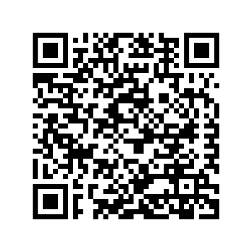
World Languages and Cultures

Slide 4
Latin and Chinese
If you have done well at WMS
If you are starting
Latin I / Chinese I Latin II / Chinese II

Slide 5
French
If you are starting
If you have done well at WMS
French I
French III

Slide 6
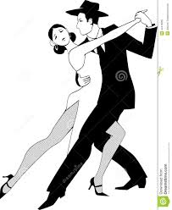
Spanish
If you are starting
If you have done well at WMS
Spanish I
Intermediate Spanish

Slide 7
For your student’s best success: …follow the recommendation of your Wydown teachers!

Slide 8
French Map

Slide 9
Spanish Map

Slide 10
Clayton High School Mission
Clayton High School’s mission is to provide an exemplary academic and extracurricular program that will guide students in the development of the character, knowledge, skills, and intellectual curiosity needed to contribute to the world around them.
Clayton High School Guiding Principles
We believe that our program must be comprehensive and challenging in order to meet the needs of our students.
We believe our school community should promote health, character, and compassion.
We believe social, ethnic, and cultural diversity enriches our school community.
We believe that learning should be a lifelong process.

